Slide 1
Forced Migration

Slide 2
Flow of Presentation
Background and Terminology
2. What leadership concepts
are applicable globally?
3. How does media cover
this issue?
4. Examination of forced
migration:
Honduras
Rohingya
5. Leadership and
Identity
6. Leadership and Power
7. Christian Perspective

Slide 3
71.44 Million
‘Persons of Concern’
Notes:
According to the UNHCR, Persons of concern is an umbrella term that refers refugees, asylum seekers immigrants and Internally Displaced People.

Slide 4
IDP & Forced Migration
Internally Displaced Person (IDP) = a group of people that have been forced to flee their home in order to avoid the effects of armed conflict, human rights violations or human made disasters.
Forced Migration = a general term that refers to the movement of refugees and internally displaced people.

Slide 5
Leadership
1. Process
2. Influence
3. Groups
4. Common Goals
Notes:
The definition of leadership that I will be using through the course of this presentation is that explained by Northouse containing 4 main parts: process, influence, groups and common goals.

Slide 6
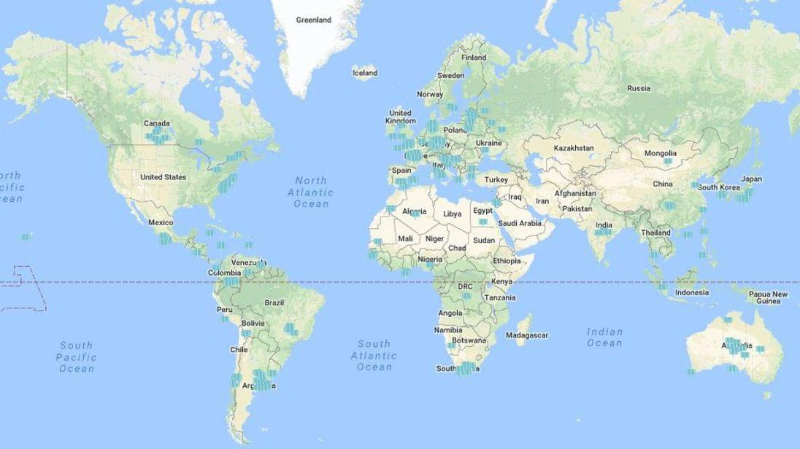
Global Leadership

Slide 7
United Nations
= hard to implement laws
International Humanitarian Law
Guidelines on how to act
Rule 129 ‘Parties in armed conflicts are specifically forbidden to deport or forcibly transfer civilians, exceptt in the event of protection’
International Criminal Court (ICC)
Prosecute 3 main crimes: genocide, crimes against humanity and crimes of aggression
Primary examination on Rohingya Forced Migration (2018)
Notes:
The UN has been the main actor tackling the issue of forced migration. They have been tackling this issues through the IHL and the ICC. The IHL provides guidelines on how a state should act, with specific reference to Rule 129. The ICC conversely, uses jurisdiction to prosecute states. Forced migration as of this point has not been included in this discussion. This may change through the Primary examination of the ICC into the Rohingya Forced Migration Crisis.

Slide 8
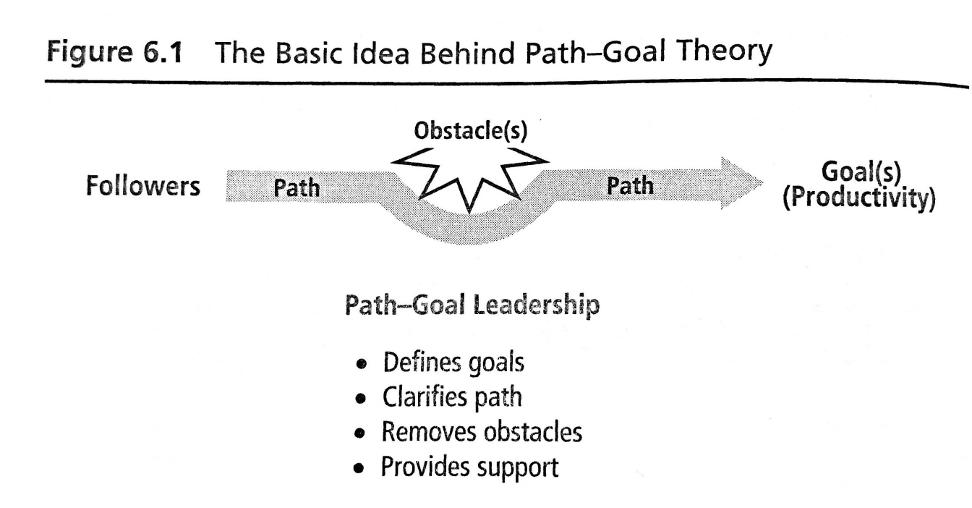
Path-Goal Theory
= Evans, House and Mitchell
Notes:
The path-goal theory is specifically relevant to that of the ICC’s techniques. The ICC through the primary examination is trying to overcome the obstacle of not have jurisdiction over states in order to prevent and raise awareness about forced migration.

Slide 9
Media Perception
Context
Different definitions of words
Unclear which has negative stigma
Biases
‘Falling standards’
Sensationalism and the use of hyperbole

Slide 10
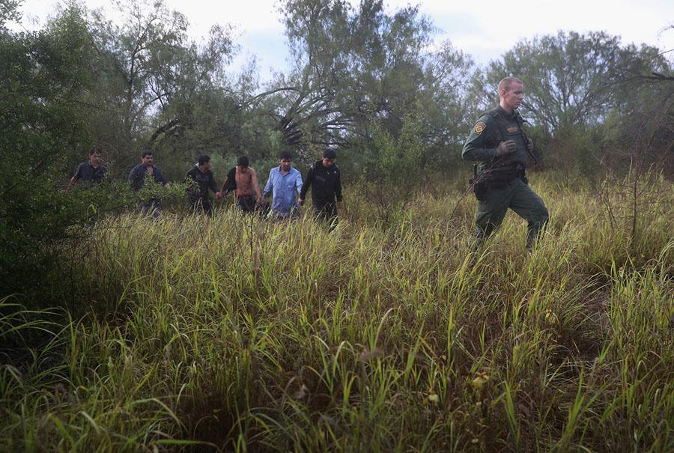
John Moore (Followership)
Notes:
John Moore provides a contrast to this typical idea of the media. He is known for his photos following the US-Mexico border crisis. He can be associated with the Leadership theory of followership as accepting the influence of others in order to achieve a common goal of bringing awareness to forced migration. In particular he is representative of the Kellerman theory (a continuum from isolates, to die hards) in which he would be seen in a higher level of development. Photo shows Mexican immigrants being led through a bush after being detained

Slide 11
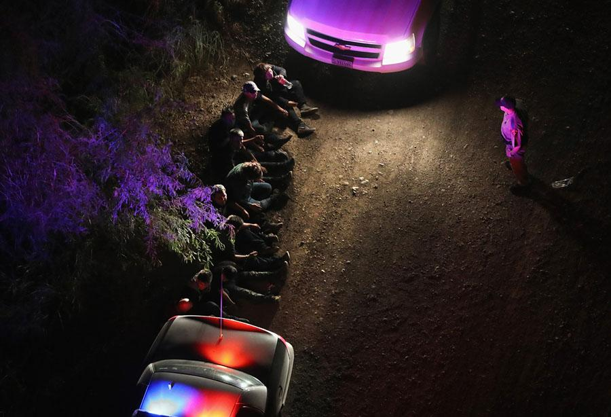
Notes:
Undocumented immigrants taken into custody

Slide 12
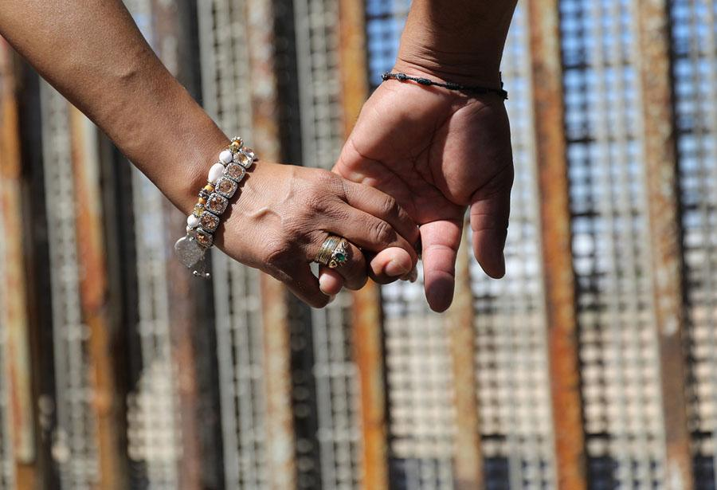
Notes:
Couple holding hands while greeting family on other side of US border

Slide 13
Honduras

Slide 14
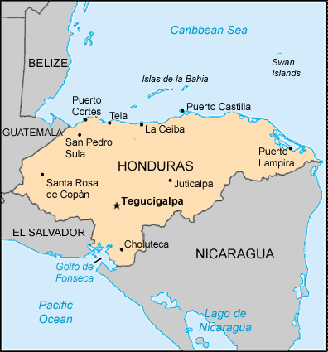
Background
3.4 million Central Americans residing in the US (85% from Northern Triangle)
Difficult visa process; often resort to unconventional means of transportation
Credits: Al Jazeera
Notes:
Northern Triangle is composed of Honduras, Guatemala, El Salvador all of which are currently suffering violence and economic desperation. Tend to flee to the US for two main reasons: economic desperation and geographical proximity. Difficult and often long visa process encourages citizens to travel through unconventional routes eg. La Bestia

Slide 15
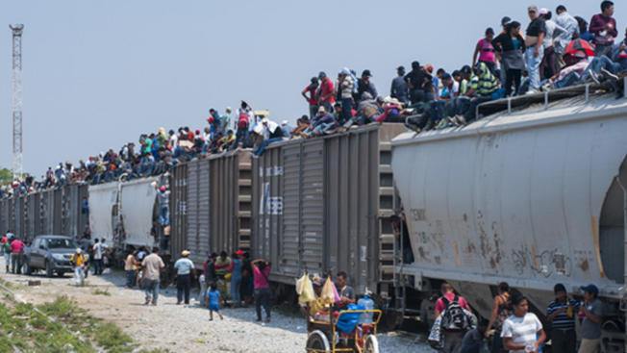
‘La Bestia’
Credits: Telemundo 51

Slide 16
‘La Bestia’ - Cont.
Dangers
Physical; heat stroke or falling off
Gangs; subject to extortion and extreme levels of violence
2. Leadership response = prevention
Mexican government; regulations to speed up trains, increase border control
US government; composition of a song to warn potential migrants of the dangers of La Bestia
Honduran government: ‘Law on protection of Immigrants’ and activities
3. Situational leadership
Hershey and Blanchard

Slide 17
2. Rohingya

Slide 18
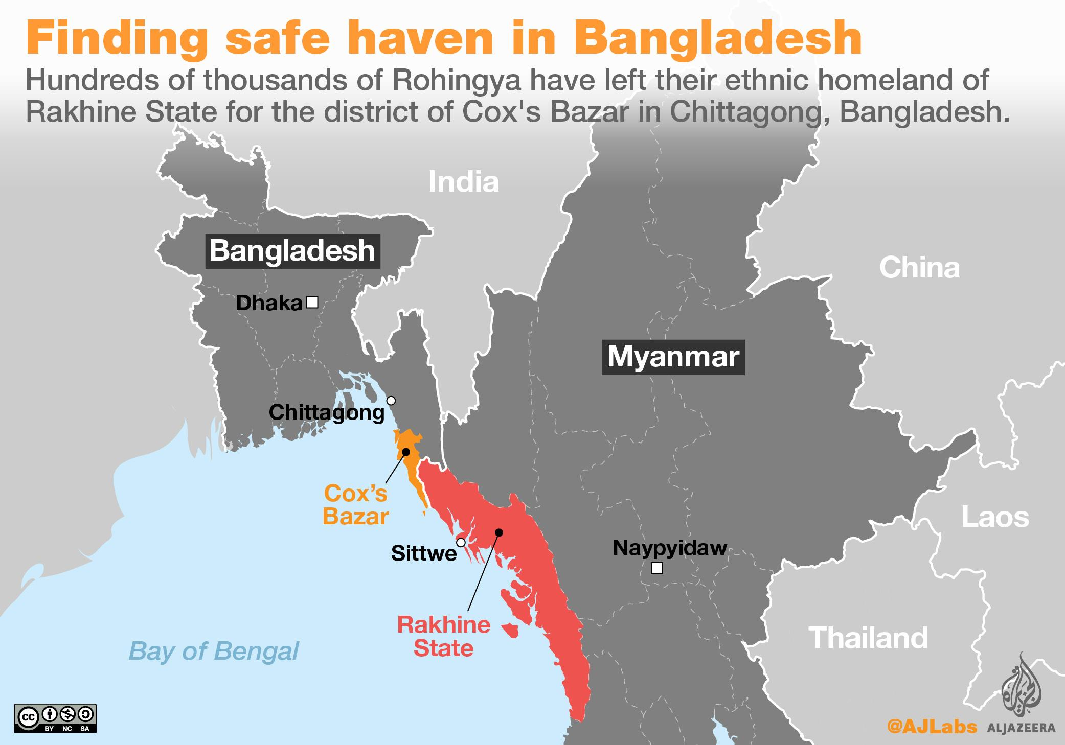
Background
95,000 refugees crossing border since 2017
Governed as a military state
Utilize power within their identity
Credits: Al Jazeera
Notes:
Military use their power within their identity to their advantage

Slide 19
Overall Changes in Leadership

Slide 20
Guiding Principles
Global State
= UN focused = Responsibility of
the government
Annual publication
Provide a set of guidelines on how to deal with IDPs

Slide 21
Religious Perspective
Hostility Hospitality
= the world’s = response through faith
response
Brought to the forefront through Matthew Kaemingk
Changing the way faith responds (Christ-like)

Slide 22
Notes:
Static, leadership is constantly changing as we have seen through the two main case studies

