Slide 1
Social Issue: Foster Care
by- Grace Tannous
LDS 1301

Slide 2
The Foster Care System and Child Protective Services
Families that have had a CPS call where the child gets displaced due to neglect or abuse.

Slide 3
Unfair and Unjust- Globally
The foster system is a problem in the world, United States, Texas, and McLennan County.
Approximated 399,546 children in the foster care system.
Developing countries have little allocation from government finances because it is focused to assistance needed other places.

Slide 4
Unfair and Unjust- United States
U.S. Department of Health and Human Services 2017 report says that the number of children in foster care has increased for the fourth year in a row.
Struggle to find homes willing to foster care results in misplacement of children.
Shortage of national social workers resulting in overworking of workers.

Slide 5
Unfair and Unjust- Texas
Number of children that cannot be immediately placed into foster homes has increased 20 percent.
Children with disruptive behaviors have been refused placements by the foster parents.
Increased expenditure towards the foster care system has been battled by Republicans.

Slide 6
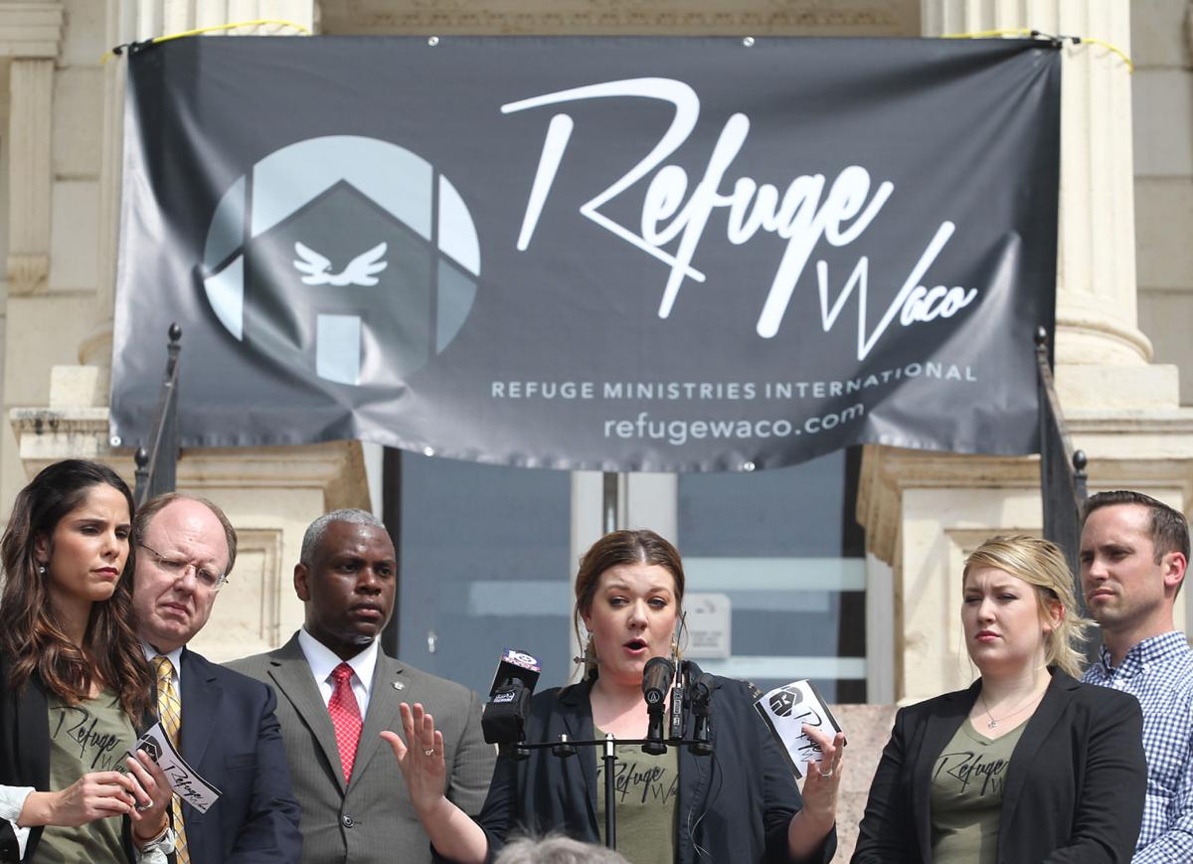
Unfair and Unjust- McLennan County
Redesigning the foster care system to help children stay in the same community they grew up in.
Refuge Waco Ministries is trying to create half-way houses for those who are not offered immediate placement in homes.
Cyclical cycle of people having been in the foster system having their kids in the foster system.

Slide 7
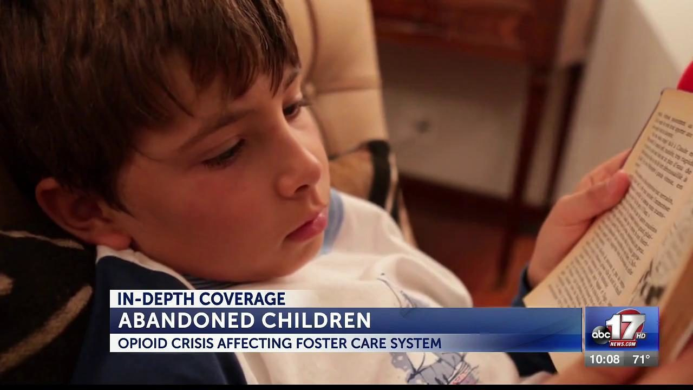
Media Coverage
Media coverage has increased.
Because they are trying to increase the amount of foster homes, aspects are overlooked and swept under the rug.
The Fosters – television show that is a drama about the happenings in foster homes.

Slide 8
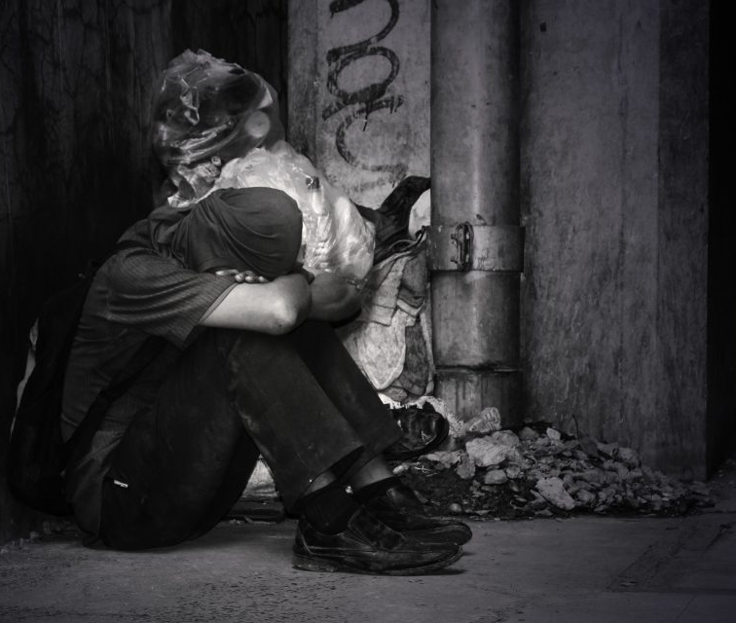
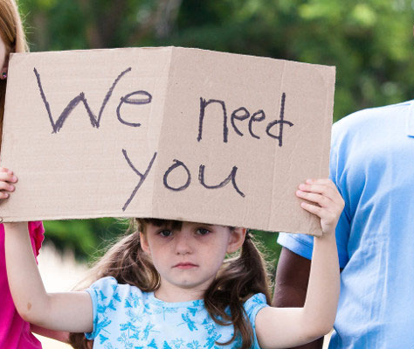
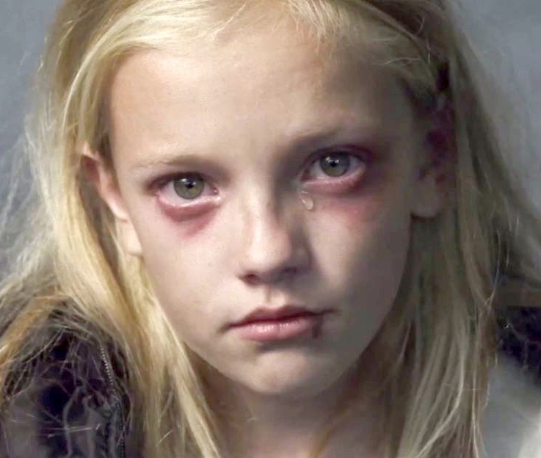
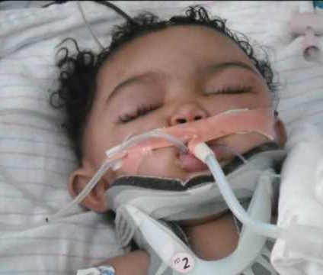

Slide 9
Physical and Emotional Abuse
Children in foster care were put in the system because of previous neglect or abuse.
Some instances where the abuse can intensify when put in foster homes.
When forced into relocation, there is a potential that it is a harsher situation.
Statute of limitations.

Slide 10
Psalm 82:3-4
“Give justice to the weak and the fatherless; maintain the right of the afflicted and the destitute. Rescue the weak and the needy; deliver them from the hand of the wicked.”
John 13:34
A new commandment I give to you, that you love one another: just as I have loved you, you also are to love one another.’’
Leviticus 19:33
‘’When a stranger sojourns with you in your land, you shall not do him wrong.’’

Slide 11
Foster Care and Leadership
Team Leadership
Six enabling conditions for effectiveness – Hackman (2012)
Compelling purpose
Team-focused coaching
Real team
Right people
Supportive organizational context
Clear norms of conduct

Slide 12
Foster Care and Leadership
Servant Leadership
Five servant leadership behaviors –Liden et al. (2008)
Putting followers first
Helping followers grow and succeed
Behaving ethically
Empowerment
Creating value for community

