Slide 1
Letter from Percy Florence Shelley to Tom Taylor
By: Catherine Burr, Alex Ueckert, and Emily Bell

Slide 2
Details of the Item
Letter from Percy Florence Shelley to Tom Taylor
It was written in 1871
Currently uncatalogued/not in the system in ABL
The letter was acquired in a 1964 Sotheby’s Lot. The lot (presumably) was targeted for the letter it contained from Robert Browning to Mrs. Tom Taylor in condolence for the passing of her husband. The lot contained other letters of condolences to Mrs. Tom Taylor from which this letter was later discovered to have been included.

Slide 3
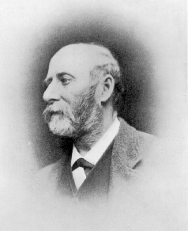
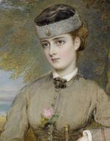
What can we learn from this item?
We first can learn details regarding the Shelley’s family life.
“The time of some of our family is a great deal employed with the arrangements connected with the approaching marriage in February--so that when I write to ask questions with respect to the Easter performances I cannot always get a hearing.”
This quote refers to Percy Florence and Jane’s (his wife) adopted daughter Bessie.
Bessie was adopted by Percy and Jane, her paternal aunt, after her own mother passed away.

Slide 4
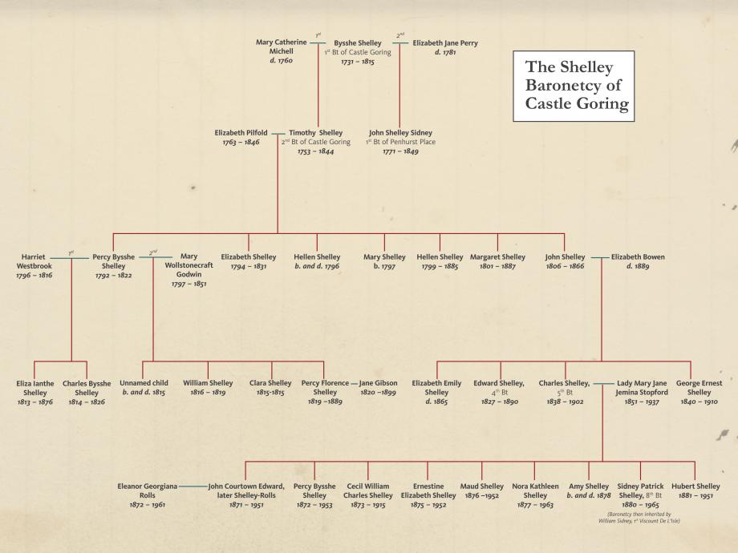

Slide 5
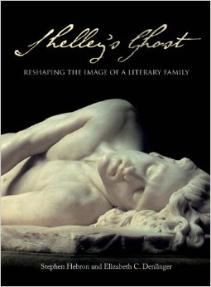
What can we learn from this item?
Shelley’s Ghost gives extensive information on the Percy and Mary Shelley, but does not speak much about Percy Florence and his family life.
Percy Shelley died when Percy Florence was 3 years old. Instead of becoming a poet like his father, he decided to become a playwright.
Plays are thus a large element in his letter.

Slide 6
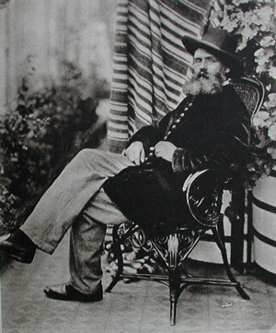
Who is Tom Taylor???
1817-1880
Born from a lower class family
Attended Trinity College, Cambridge
Studied English and mathematics
A leading playwright and actor between the 40s-60s
Great adapter of other work

Slide 7
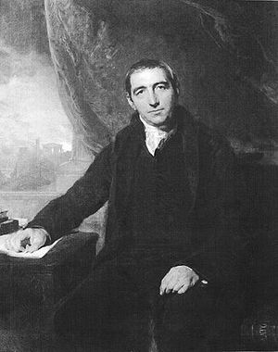
Tom + Florence
“The dialogue is very superior to what we are usually treated to, being full of natural touches, sparkling sentences, and occasionally a touch of poetry…. Real good honest laughter, real tears of pathos”
-The Leader
o Two Loves and a Life brought together what Florence Shelley desired for his plays and what society accepted as appropriate.
o This reflects how Florence conforms to the standards that society placed on him, and this is interesting because his father was a total rebel.

Slide 8
Discussion Question #1
Why do you think Percy Florence decided to pursue theatre and playwriting as opposed to writing poetry like his mother and father?

Slide 9
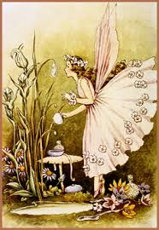
Where are They Now?
Works Mentioned:
A Fairy Tale : Florence Shelley has two copies in the British Museum.
Two Love and a Life : By Tom Taylor
Lighthouse, Altafash on the Doctor, and Domestic Economy : Currently have not found anything about these.
The significance of this is the fact that most of his plays are not in the eye of the public. This contrasts with the popularity and endurance of his parents.

Slide 10
Understanding the Plays and Their Author
In the letter it states:
“I send you “a Fairy tale” which I have written & which is devoid of slang – that was according to order – what is worse than the absence of slang in your eyes I’m afraid – there is also an absence of fun – But our audience will be pleased with it in the way we shall manage it I really think.”
~ One can understand the way in which Florence wanted to keep the peace and order with his art.
~ Was not someone who was wanting to rock the boat like his father.
~ Even though he enjoyed “slang” that was humorous, he did not attempt to write such plays so that he would be admired.

Slide 11
Discussion Question #2
Percy Florence and Tom Taylor decide to not use slang in A Fairy Tale to maintain a theme of propriety. Do you think this has anything to do with their relative obscurity now? Or do you think it is just more difficult to become lastingly popular as a playwright in general?

Slide 12
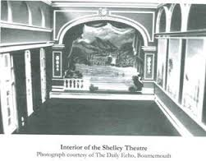
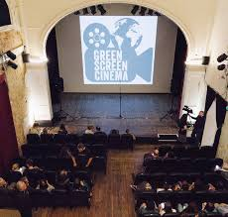
The Shelley Theatre
Then: Now:

Slide 13
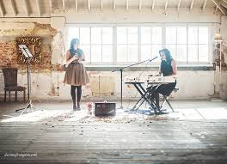
#Funfacts #Almostdone #Y’allareawesome
# Restoration began 10 years ago
# The venue has been up and running as a creative space for people of the community.
# They’re open for theatre, film, dance, and live music for most half of the year.
#Keepingtheshelleysalive #momwouldbeproud

