Slide 1
Coleridge’s Biographia Literaria
Jennifer Reeves, Abigail Thompson, Ben Koshy

Slide 2
Nature of the Item
Samuel Taylor Coleridge, Biographia Literaria, or, Biographical sketches of my literary life and opinions (London: Rest Fenner, 1817), first edition. First edition. Volume 1 includes the contemporary ownership inscription of Margaret Scott on the title-page. With a few annotations in the text of both volumes and on the original front free endpaper of volume 1 in an unknown contemporary hand. This is an entirely uncut copy with the half-titles and final publisher ads at the end of volume 2; the volumes have been rebound in quarter calf and marbled boards.
It was thought to have been owned by Rev. Alexander John Scott as well. The book contains some of Coleridge’s famous thoughts on imagination as well as “fancy”. The book also contains his use of the “willing suspension of disbelief” which is a phrase that he coined. The copy does contain inscriptions by its owners which is something researchers can use to learn about its owners.
Notes:
First Edition: owned by Rev. Alexander John Scott and then his daughter Margaret Scott according to inscriptions found on the title page
Annotations and notes found throughout both volumes of the text and a letter on the front flyleaf
Unclear who made which marks, however we can use them to speculate about the influence that the work might’ve had on these specific people as well as society as a whole

Slide 3
Biographia Literaria
1817
Autobiographical and philosophical work of literary criticism
He recognizes differences between his perspective and Wordsworth’s
He has a religious view of poetic imagination and an interest in the supernatural and mysterious depths of the mind and cosmos
Coleridge believes that there is more to reality than we can see, taste, touch, or measure

Slide 4
Imagination
Primary: When the brain intakes images of what’s around you and makes it coherent; even to see the world is a creative act; doing what God does on a much smaller scale; involuntary
Secondary: You choose to do this; You break down the world you know and you put it back together; making something new that wasn’t there before; art, writing; places together things we usually think of as opposites
“It was a miracle of rare device, A sunny pleasure-dome with caves of ice.”
Fancy: Mental activity that links and puts things together already in our memory without forming anything new; like memory; not creative; not seeing the world in a new way
“And like a lobster boiled, the morn / From black to red began to turn”
Notes:
Wordsworth writes about mundane and everyday things though he is still writing about the world in a new way

Slide 5
Alexander John Scott: Flyleaf Annotation
Inscription
See Edinburgh Rev. for August for a critique upon this week written by Mr. Jeffrey
See also “Spirit of the Age” by W Hazlitt: p: 61. Considered one of the best articles in that work:
One of the earliest and most intimate friends of Mr. Coleridge was the late Sir H. Davy; whose literary talents, as Sir W Scott has observed were almost as remarkable as his wonderful scientific attainments. The following extract from some of Sir Humphry’s letter published in his life by Dr. Paris shew that illustrious man’s opinion of Mr. Coleridge in so favourable a view that I have given them here verbatim. Oct: 1804: letter to Tho. Poole Esq. p.127:
“I have rec’d [received] a letter from Coleridge within the last 3 weeks: he writes from Malta in good spirits & as usual from the very depths of his being. God bless him: He was intended for a great man: I hope & trust he will at some period appear such.”

Slide 6
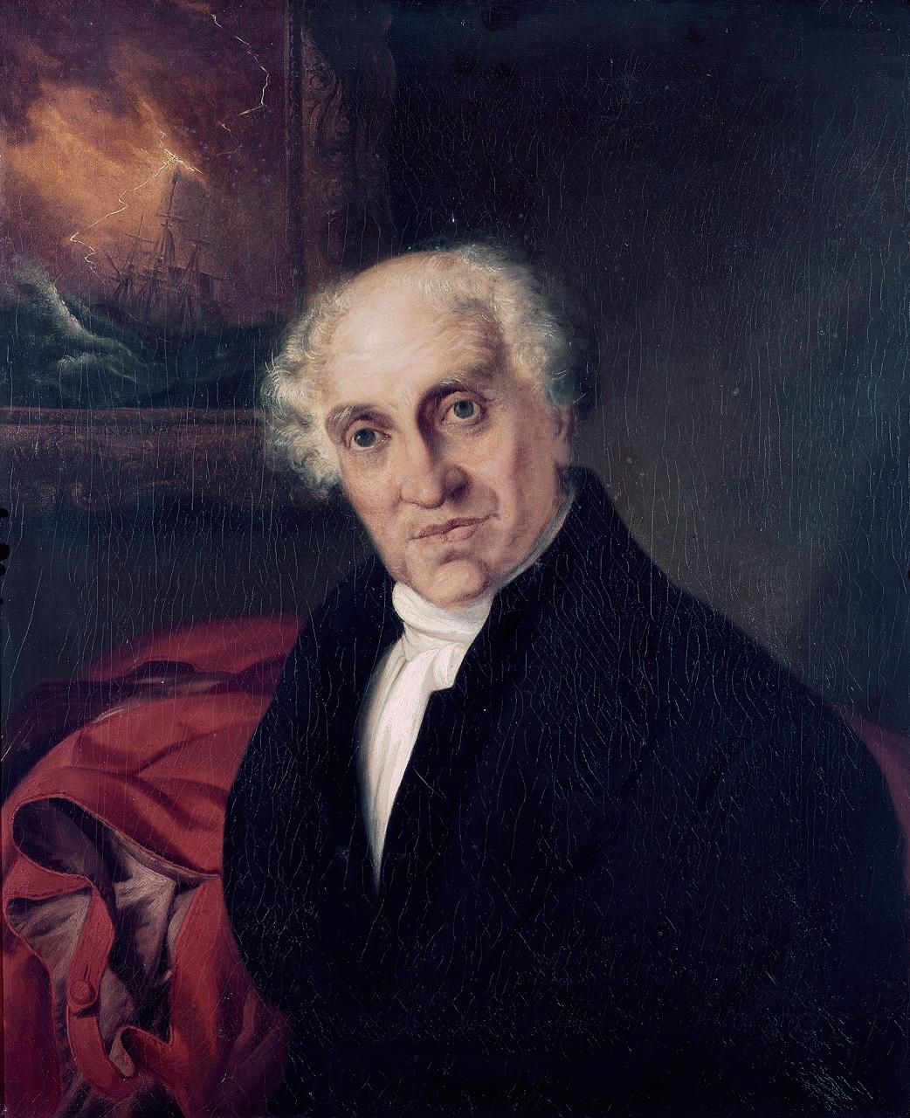
Alexander John Scott
Naval chaplain
Loved and knew multiple languages
Large library at the end of life
Good classicist
Sir Humphry Davy
Self education included-chemistry, botany, and anatomy needed for part of his profession, included physics and mechanics
Declaiming poetry in wild outdoors
Also reading Locke and other philosophy
Notes:
Discuss connections
What do we find interesting about Scott? He was a priest that was very into science and philosophy, what do we know about the relationship between science and religion in the 18th-19th century?
Influenced how he raised his daughter, large library and its rare for a religious person to be interested in science

Slide 7
Thoughts?
What is the importance of Rev. Scott’s interaction with science and natural philosophy?

Slide 8
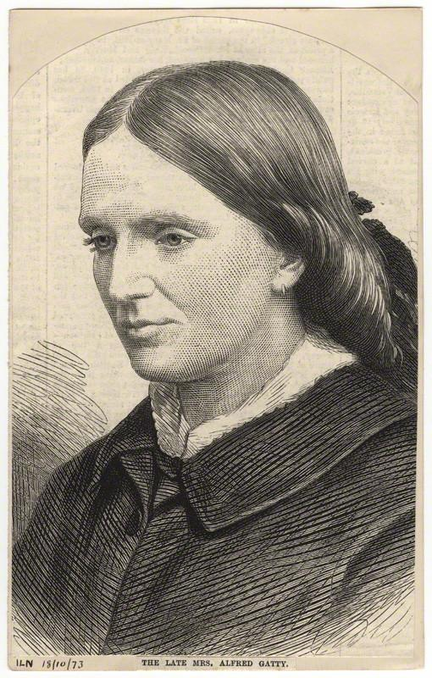
Margaret Scott Gatty
Alexander J. Scott’s daughter
Born in Burnham Essex 1809
Her father had a large influence on her education and language skills
Married Alfred Gatty in 1839 (local curate)
Interests: Writing and botany (naturalist)
Similar to her father in that regard
Wrote “didactic fairy tales” and science influenced works: Parables in Nature, The Fairy Godmothers, The Poor Incumbent, An Irish Holiday, Proverbs Illustrated, Legendary Tales, The Human Face Divine, History of British Seaweeds
Notes:
i.Collaborated with and had connections with scholars and experts who shared passion of classifying seaweed

Slide 9
Margaret Scott: p.300 Inscription
Pencil line marking a section:
“O we are querulous creatures! Little less/ than all things can suffice to make us happy:/ And little more than nothing is enough/ to make us wretched”
From Parables of Nature; Knowledge not the Limit of Belief
Bookworm: “I do not mean to be rude, I assure you. You are both of you very beautiful creatures, and, I dare say, very useful too. But you should not fancy either that you do know everything, or that you are able to know everything. And, above all, you should not dispute the superiority and powers of another creature merely because you cannot understand them."
Notes:
coincides with her work in Parables for Nature; she could have been influenced by Coleridge’s statement
Metaphors with creatures and expanse of knowledge and superiority
Zapyola
Identifies with Coleridge’s romantic ideals

Slide 10
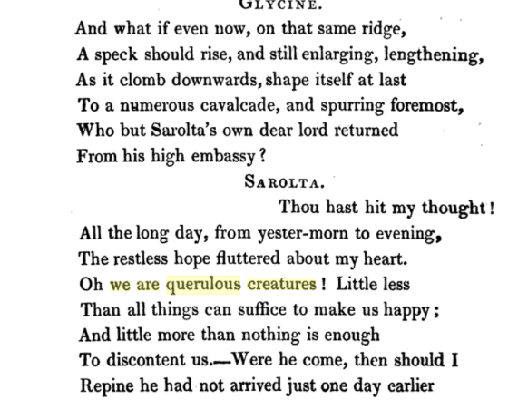
Notes:
What is a common theme seen amongst Margaret and her father and their relation to Coleridge? What influence?

